Slide 1
Intro to Front End Web Development
HTML, CSS, JavaScript

Slide 2
Basic Keyboard Shortcuts for Coders
CMD + / → Commenting
CMD + A → Select All
CMD + C → Copy
CMD + X → Cut
CMD + P → Paste
CMD + Z → undo last
CMD + Y → redo last
CMD + S → Save
CMD + Option + I → Open console
CMD + Shift + D → Copy current highlighted line and paste underneath
CMD + Shift + Arrow (left/right) → highlights the entire line.

Slide 3
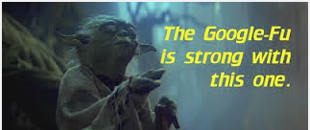
HTML
1.) Open up either sublime or atom text editor – OR you can use http://www.jsbin.com
2.) MDN - https://developer.mozilla.org/en-US/
3.) Google-fu is defined as "skill in using search engines (especially Google) to quickly find useful information on the Internet." It is a somewhat tongue-in-cheek reference to kung-fu, which is generally perceived as requiring a high degree of skill to master in the western hemisphere.

Slide 4
HTML
<!DOCTYPE html>
<html>
<head>
<meta charset="utf-8">
<meta name="viewport" content="width=device-width">
<title>Front End Web Development</title>
</head>
<body>
Code in here will show up in your browser.
</body>
</html>
Meta tags are snippets of text that describe a page's content; the meta tags don't appear on the page itself, but only in the page's code.

Slide 5
HTML Elements
<h1></h1>
<h2></h2>
<p></p>
<span></span>
<ul>
<li></li>
<li></li>
</ul>
<ol>
<li></li>
<li></li>
</ol>
<div></div>

Slide 6
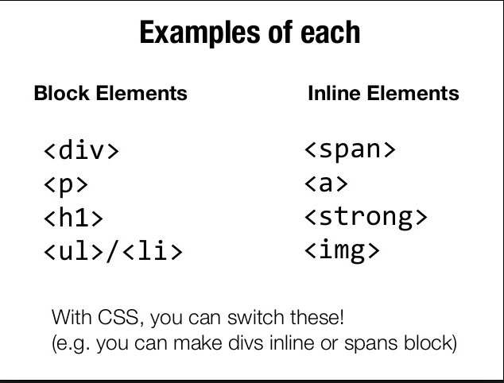
Block: elements are usually either "block-level" elements or "inline" elements. A block-level element occupies the entire space of its parent element (container), thereby creating a "block.” Inline: inline elements can start anywhere in a line.

Slide 7
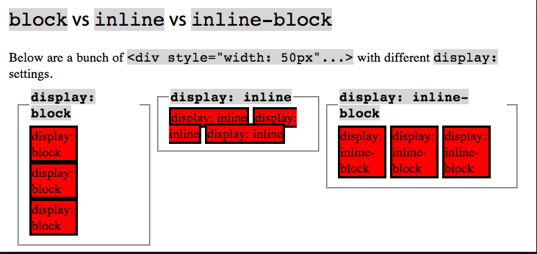
Block vs Inline Elements

Slide 8
Absolute vs relative path
<a href=http://www.mysite.com>Click Me</a>
<a href="linkhere.html">Click Me</a>
/graphics/image.png
^ (above) means it goes into the graphics folder aka “directory”
<a href="/pictures/tahiti-vacation/tahiti.html">Read about my Tahiti vacation.</a>
HTML5 → https://html5test.com/ → This will tell you immediately If your browser supports
<nav></nav>
<main></main>
<aside></aside>
<hr>
<address></address>

Slide 9
CSS & Specificity
<link rel="stylesheet" type="text/css" href="theme.css">
Styling the element p {
color: red;
text-align: center;
}
Styling by class
.class-name {
text-align: center;
color: red;
}
Styling by Id
#para1 {
text-align: center;
color: red;
}

Slide 10
CSS
Styling more than 1 element at a time
h1, h2, h3, h4 {
color:blue;
font-weight:bold;
}
Styling only paragraphs with the class “center”
p.center {
color:red;
}
Styling only a span tag that’s within a paragraph that’s within a div
div > p > span {
color: blue;
}

Slide 11
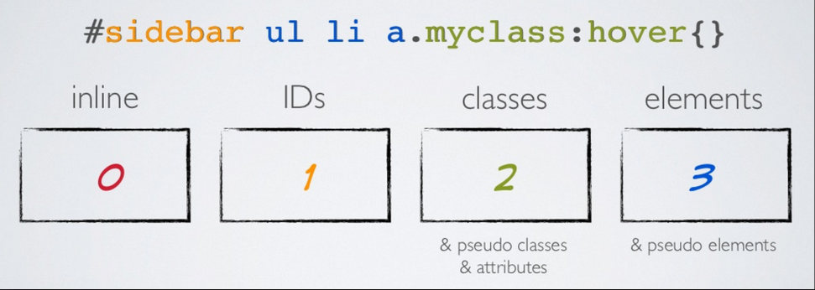
CSS & Specificity

Slide 12
CSS vs HTML to style elements
<img src="images/firefox-icon.png" alt="My test image">
Exercise: Make a static webpage using only HTML.
<p>My cat is <strong>very</strong> grumpy.</p>
<p>My cat is <span class=“tag”>very</span> grumpy.</p>

Slide 13
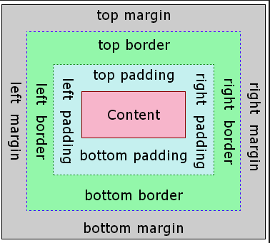
CSS

Slide 14
CSS
box-sizing
height
margin
margin-bottom, margin-left, margin-right, margin-top
max-height
max-width
min-height
min-width
overflow
overflow-x
overflow-y
padding
padding-bottom, padding-left, padding-right, padding-top
visibility
width

Slide 15
Positioning
position: static;
position: relative;
position: absolute;
position: fixed;
static
This keyword lets the element use the normal behavior, that is it is laid out in its current position in the flow. The top, right, bottom, left and z-index properties do not apply.
relative
This keyword lays out all elements as though the element were not positioned, and then adjust the element's position, without changing layout (and thus leaving a gap for the element where it would have been had it not been positioned). The effect of position:relative on table-*-group, table-row, table-column, table-cell, and table-caption elements is undefined.
absolute
Do not leave space for the element. Instead, position it at a specified position relative to its closest positioned ancestor or to the containing block. Absolutely positioned boxes can have margins, they do not collapse with any other margins.
fixed
Do not leave space for the element. Instead, position it at a specified position relative to the screen's viewport and don't move it when scrolled. When printing, position it at that fixed position on every page. This value always create a new stacking context.

Slide 16
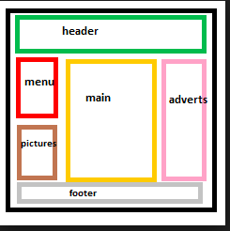
Exercise
* Try creating and styling elements – use background-color to see what’s happening with your divs
Ex. Create a layout

Slide 17
JavaScript
JavaScript ("JS" for short) is a full-fledged dynamic programming language that, when applied to an HTML document, can provide dynamic interactivity on websites. You must include the script tag below to link your JavaScript file with your html.
<script src="scripts/main.js"></script>
Variables are containers that you can store values in. You start by declaring a variable with the var keyword, followed by any name you want to call it:
var myVariable;
function colorChange() {
var element = document.getElementById('element');
element.style.background = '#ff00aa';
}
On the element itself – you’d have to put an “id” and an “onclick” to run the above function (see below).
<button onclick="colorChange()">
Change Color
</button>
<img id="kitty" src="img/kittens.jpg" alt="kittens">

Slide 18
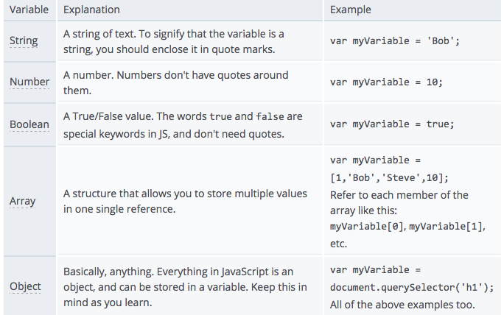
Variables

Slide 19
Arrays & Objects
Arrays = [];
var arr1 = [1,2,3,4];
var arr2 = [“cat”, “dog”, “bird”];
Objects = {};
var obj1 = {name:”Kelly”, age:45, city:”Brooklyn”};
var obj2 = {title:”The Good Earth”, genre:”fiction”};
Array of objects
var customers = [{}, {}, {}];
var customers = [{name:”Kelly”, age:45, city:”Brooklyn”}, {name:”Tim”, age:25, city:”Miami”}, {name:”Charlie”, age:19, city:”Port Jefferson”}];
Object of Arrays
var customer = {name: “Kelly”, product_ids: [21, 33, 45], phone:777-777-7777}

Slide 20
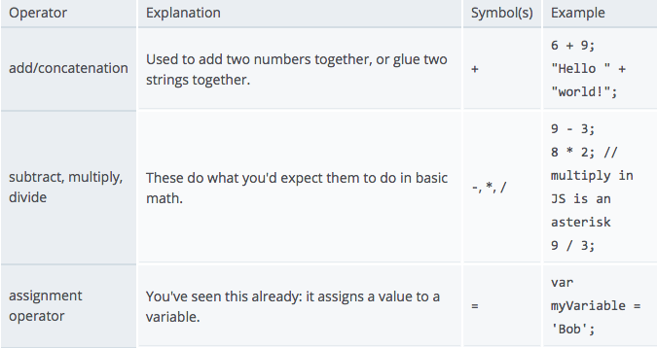
Operators

Slide 21
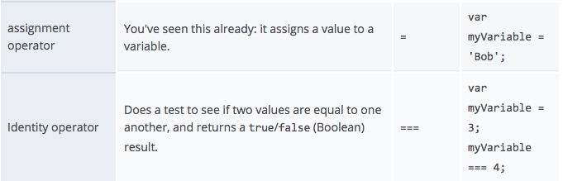
Operator

Slide 22
Conditionals
var iceCream = 'chocolate';
if (iceCream == 'chocolate') {
alert('Yay, I love chocolate ice cream!');
} else if ( iceCream == ‘vanilla’) {
// Do something else
} else {
alert('Awwww, but chocolate is my favorite...');
}
________________________________________________________________
Ternary Conditionals
iceCream == ‘chocolate’ ? updateProduct() : deleteProduct();

Slide 23
Functions
function multiply(num1,num2) {
var result = num1 * num2;
return result;
}
multiply(4,7);
multiply(20,20);
console.log(multiply(0.5,3));
http://www.creativebloq.com/web-design/examples-of-javascript-1233964

Slide 24
Change button color on click
<script>
var count = 1;
function setColor(btn, color) {
var property = document.getElementById(btn);
if (count == 0) {
property.style.backgroundColor = "#FFFFFF"
count = 1;
}
else {
property.style.backgroundColor = "#7FFF00"
count = 0;
}
}
</script>

Slide 25
Change image into another by clicking it
1.) Find 2 images
2.) Put into html
Make this function work – so when you click on the image it changes.
var myImage = document.querySelector('img');
myImage.onclick = function() {
var mySrc = myImage.getAttribute('src');
if (mySrc === 'images/puppy.png') {
myImage.setAttribute ('src','images/kitten2.png');
} else {
myImage.setAttribute ('src','images/puppy.png');
}
}

Slide 26
Front-End Web Development Course
6 week course
Sat 2/20 – 3/26/16 → 10:00am-4:00pm
HTML5/CSS3
Javascript/JQuery
Git/Github
Using BootStrap/Themes
Responsive & Mobile
Angular JS – front-end framework for JavaScript
** Have a dynamic website for your portfolio at the end : )

Slide 27
Bootstap/Themes
Add bootstrap/themes link here
http://getbootstrap.com/
Examples: https://bootstrapbay.com/blog/built-with-bootstrap/
How to style it → List of bootstrap classes
http://tomasjanecek.cz/en/clanky/post/list-of-bootstrap-3-css-classes-with-description Themes → ThemeForest
http://themeforest.net/page/top_sellers
Example:
http://themeforest.net/item/salient-responsive-multipurpose-theme/full_screen_preview/4363266

